Slide 1

Tank Trouble Bot - AI Project
Luka Ivanišević RA 125-2021
Luka Vranješević RA 131-2021

Slide 2
Problem
In this project we wanted to: 1) Set the suitable enviroment so we can solve the 2) problem
2) Make an AI tank bot that can hit his enemy with accurate and smart shots

Slide 3
Enviroment
Our enviroment consists of 2D continual space in which 2 tanks move. Our primary goal was to train one agent so it effectively shoots the other.

Slide 4
Enviroment
Action space
Our main agent can do 5 possible actions:
1) move up
2) move down
3) rotate to left
4) rotate to right
5) shoot

Slide 5
Enviroment
Observation space: Main agent gets 7 informations: 1) X coordinate of its tank
2) Y coordiante of its tank
3) Rotation angle of its tank
4) X coordinte of enemy tank
5) Y coordinate of enemy tank
6) Rotation angle of enemy tank
7) Angle of rotation at which its tank should aim for so it has a chance of hitting the enemy

Slide 6
Solution
RL
Reinforcement learning is a machine learning training method based on rewarding desired behaviors and/or punishing undesired ones. In general, a reinforcement learning agent is able to perceive and interpret its environment, take actions and learn through trial and error.

Slide 7
Solution
PPO
Proximal Policy Optimization (PPO) is a popular reinforcement learning algorithm that combines the benefits of policy gradient methods and trust region policy optimization. It works by iteratively optimizing a surrogate objective function while ensuring that the new policy does not deviate significantly from the old policy, using a clipping mechanism to maintain stability and reliability in training. PPO is widely used due to its simplicity, efficiency, and effectiveness in various complex environments.

Slide 8
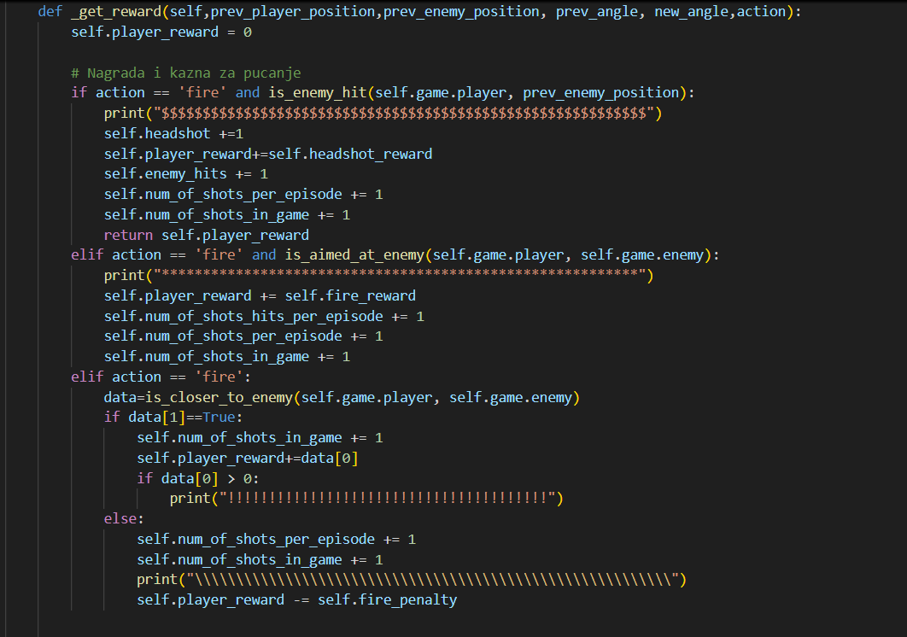
Solution
Reward/Penalty system

Slide 9
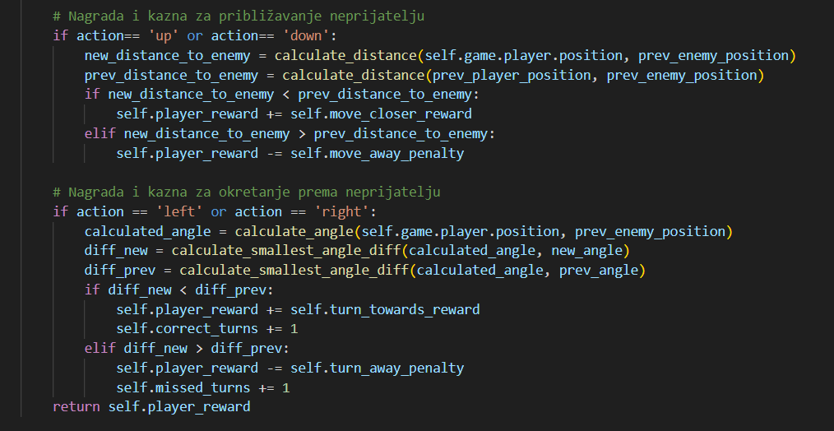
Solution
Reward/Penalty System

Slide 10
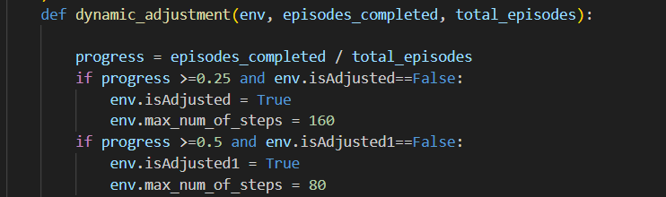
Solution
Reward/Penalty System

Slide 11
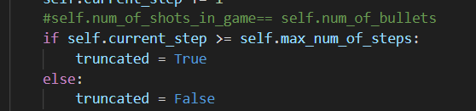
Training Process
Truncation condition:
End condition:

Slide 12
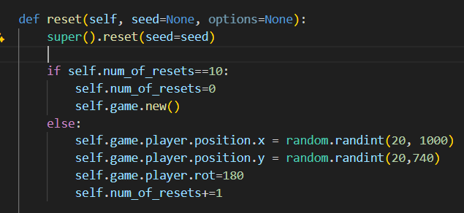
Training Process
Redefining reset method:

Slide 13
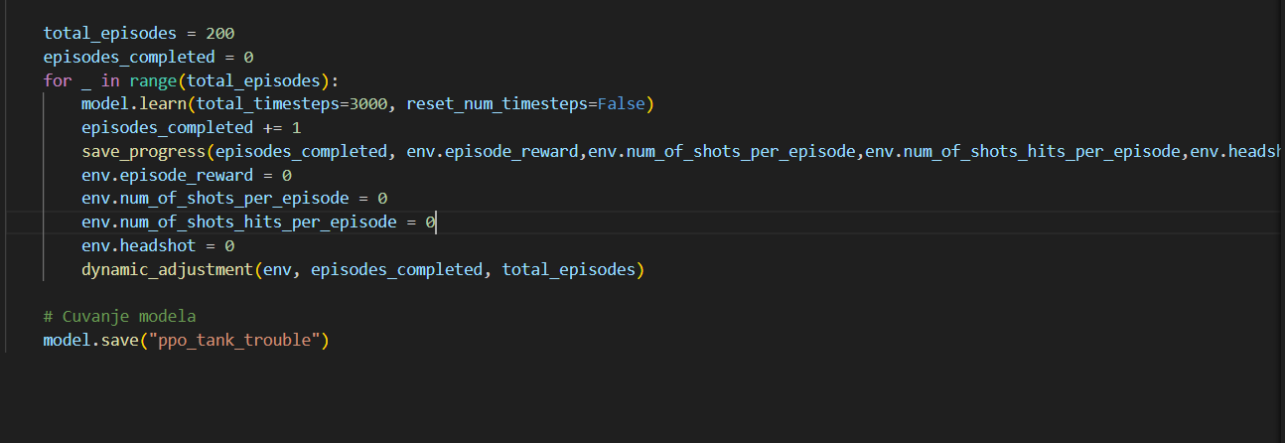
Training Process
Training loop:

Slide 14
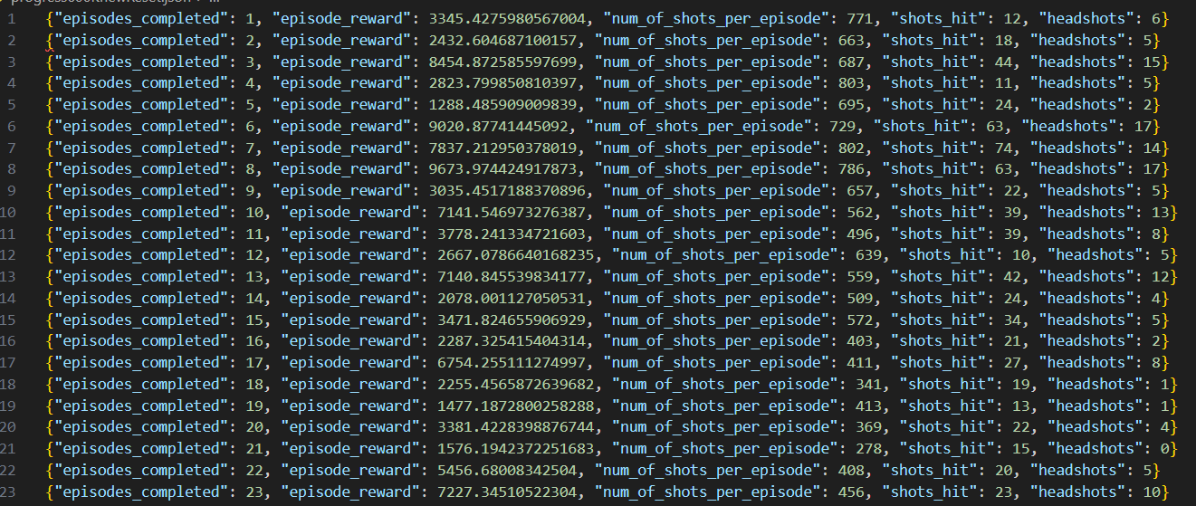
Final Results
Initial iterations:

Slide 15
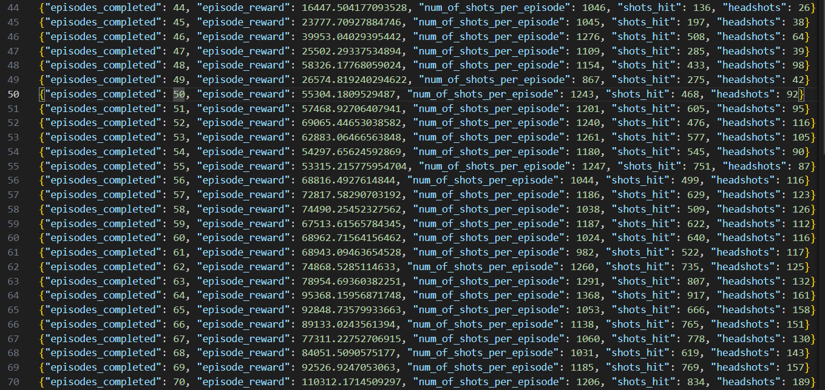
Final Results
Further iterations:

Slide 16
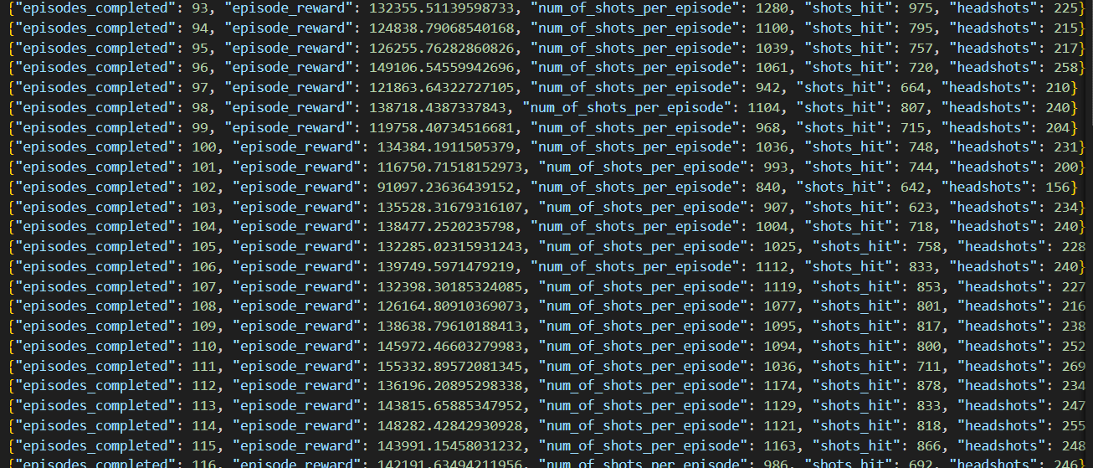
Final Results
Further iterations:

Slide 17
Final Results
Finishing iterations:

Slide 18
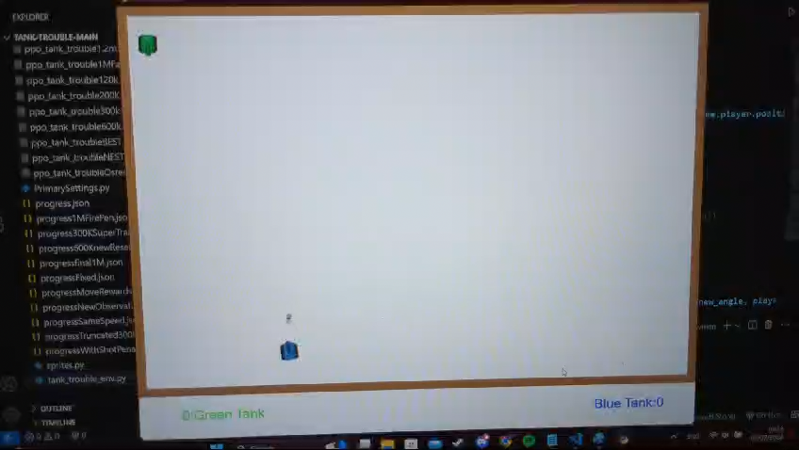
Final Results

Slide 19
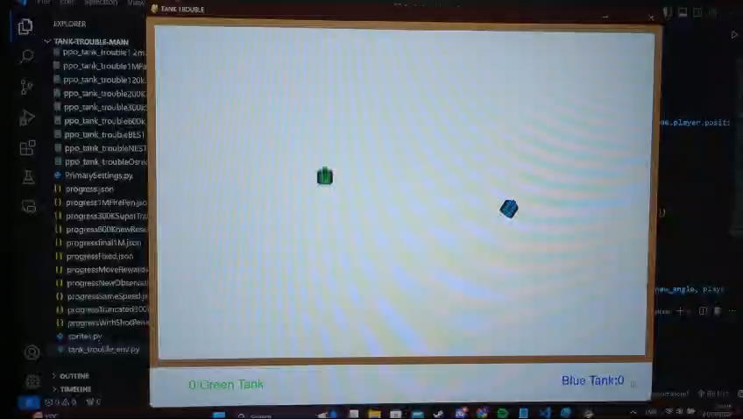
Final Results

